Slide 1
SIT TEST WITHIN THE ROTATING WAVE APPROXIMATION

Slide 2
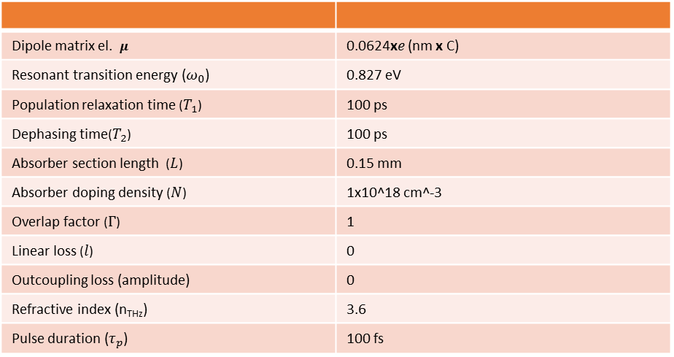
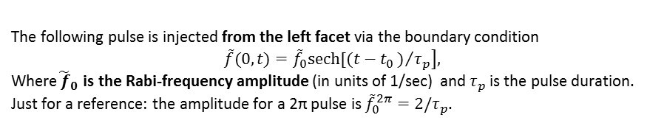
Goal:
  Verify simulation results against analytical such, based on McCall’s area theorem theory [1].
  Reproduce the SIT results, published by Ziolkovski [2], however this time within the rotating wave approximation .
  Verify behaviour for π, 2π,3π and 4π pulses propagating inside a 2 level absorber
Absorber section/Ziolokovski parameters
Dipole matrix el. $μ$ | 0.0624x$e$ (nm x C)
Resonant transition energy ($ω_{0}$) | 0.827 eV
Population relaxation time ($T_{1}$) | 100 ps
Dephasing time($T_{2}$) | 100 ps
Absorber section length ($L$) | 0.15 mm
Absorber doping density ($N$) | 1x10^18 cm^-3
Overlap factor ($Γ$) | 1
Linear loss ($l$) | 0
Outcoupling loss (amplitude) | 0
Refractive index (n_{THz}) | 3.6
Pulse duration ($τ_{p}$) | 100 fs
Normalized EOM
With the normalization condition:
Boundary conditions
With the normalization condition
– the field is normalized to the Rabi frequency:
The following pulse is injected from the left facet via the boundary condition
$$\left.\tilde{f}(0,t)={\tilde{f}}_{0}sech[(t−t_{0})/{τ_{p}}\right],$$
Where${\tilde{ f}}_{0}$ is the Rabi-frequency amplitude (in units of 1/sec) and $τ_{p}$ is the pulse duration.
Just for a reference: the amplitude for a 2π pulse is ${\tilde{f}}_{0}^{2π}=2/τ_{p}$.

Slide 3
Results: π-pulse
100
1
)
0.5
.
s
t
i
n
n
o
u
i
.
s
b
r
r
e
a
50
0
v
(
n
y
i
t
.
i
p
s
o
n
p
e
t
n
I
-0.5
0
0
50
100
-1
150
Distance (
m)
  Full population shift in of the medium is observed.

Slide 4
Results: 2π-pulse
400
1.5
1
)
s
t
i
n
n
o
u
0.5
i
.
s
b
r
r
e
a
v
(
200
n
y
i
t
.
i
p
s
0
o
n
p
e
t
n
I
-0.5
0
0
50
100
-1
150
Distance (
m)
  Two full inversions of the population are observed. No distortion of the pulse symmetry. Transparent propagation is reached and it is sustained over many round trips -> the pulse propagates as a soliton in this medium.

Slide 5
Results: 3π-pulse
1500
1
)
s
t
i
1000
n
n
o
u
i
.
s
b
r
r
e
a
v
(
0
n
y
i
t
.
i
p
s
o
n
p
e
t
500
n
I
0
0
50
100
-1
150
Distance (
m)
  Three inversions of the population are observed

